Slide 1
Virtual function

Slide 2
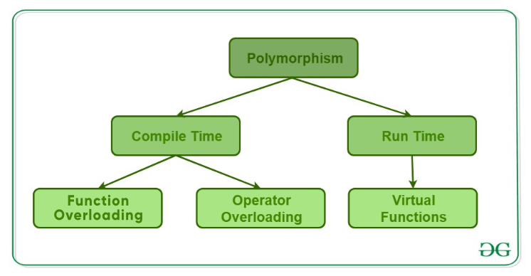
Types of polymorphism

Slide 3
Compile time polymorphism
The overloaded member functions are 'selected' for invoking by matching arguments, both type and number.
This information is known to the compiler at the compile time and, therefore, compiler is able to select the appropriate function for a particular call at the compile time itself.
This is called early binding or static binding or static linking.
Also known as compile time polymorphism, early binding simply means that an object is bound to its function call at compile time.

Slide 4
Run time polymorphism
It would be nice if the appropriate member function could be selected while the program is running. This is known as run time polymorphism.
At run time, when it is known what class objects are under consideration, the appropriate version of the function is invoked.
Since the function is linked with a particular class much later after the compilation, this process is termed as late binding.
It is also known as dynamic binding because the selection of the appropriate function is done dynamically at run time.

Slide 5
Virtual functions
A virtual function is a member function which is declared within a base class and is re-defined(Overriden) by a derived class.
When you refer to a derived class object using a pointer or a reference to the base class, you can call a virtual function for that object and execute the derived class’s version of the function.
Virtual functions ensure that the correct function is called for an object, regardless of the type of reference (or pointer) used for function call.
They are mainly used to achieve Runtime polymorphism
Functions are declared with a virtual keyword in base class.
The resolving of function call is done at Run-time.

Slide 6
Rules for Virtual Functions
Virtual functions cannot be static and also cannot be a friend function of another class.
Virtual functions should be accessed using pointer or reference of base class type to achieve run time polymorphism.
The prototype of virtual functions should be same in base as well as derived class.
They are always defined in base class and overridden in derived class. It is not mandatory for derived class to override (or re-define the virtual function), in that case base class version of function is used.

Slide 7
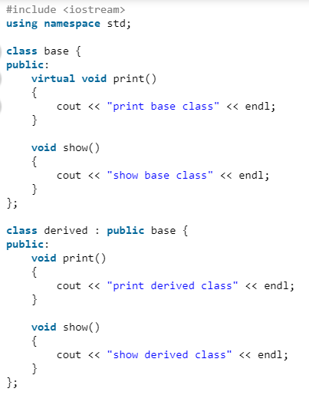
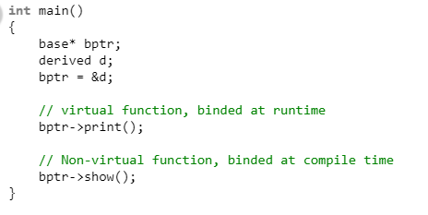
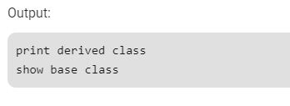
Example

Slide 8
Namespace
Same situation can arise in your C++ applications. For example, you might be writing some code that has a function called xyz() and there is another library available which is also having same function xyz(). Now the compiler has no way of knowing which version of xyz() function you are referring to within your code.
A namespace is designed to overcome this difficulty and is used as additional information to differentiate similar functions, classes, variables etc. with the same name available in different libraries. Using namespace, you can define the context in which names are defined. In essence, a namespace defines a scope.

Slide 9
Defining a Namespace
A namespace definition begins with the keyword namespace followed by the namespace name as follows −
namespace namespace_name
{
// code declarations
}
To call the namespace-enabled version of either function or variable, prepend (::) the namespace name as follows −
name::code; // code could be variable or function.

Slide 10
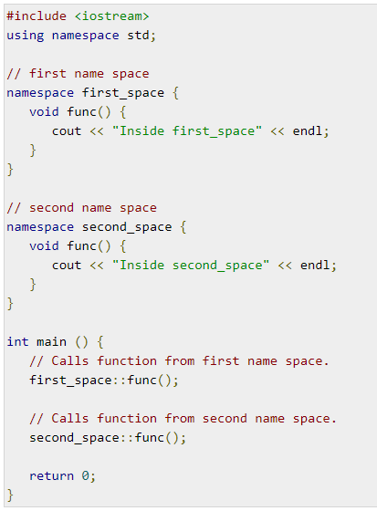

Example

Slide 11
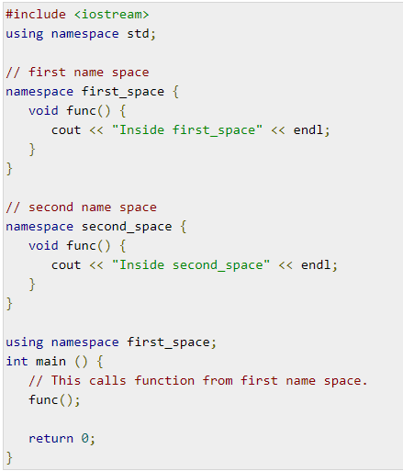

The using directive
You can also avoid prepending of namespaces with the using namespace directive. This directive tells the compiler that the subsequent code is making use of names in the specified namespace.

Slide 12
Nested Namespaces
Namespaces can be nested where you can define one namespace inside another name space as follows −
namespace namespace_name1 {
// code declarations
namespace namespace_name2 {
// code declarations
}
}
You can access members of nested namespace by using resolution operators as follows −
// to access members of namespace_name2
using namespace namespace_name1::namespace_name2;
// to access members of namespace:name1
using namespace namespace_name1;

Slide 13
